Slide 1
CS-GY 6313 B: Information Visualization
9/5/2024

Slide 2







Who are we?
Instructor
TA
Dr. Niall Williams
Research focuses on AR/VR, computer graphics, and applied human perception
“Niall” is pronounced the same as “Nile” (like the river)
nlw4415@nyu.edu
Lokesh Shanmugam
“Hi everyone, I'm Lokesh, your TA and a second-year CS graduate student. I'm excited to work with you this semester! I will be posting my office hours soon, and in the meantime, feel free to reach out to me at ls6110@nyu.edu”
Notes:
Computer generated environment
Accurate position tracking and stereo rendering → perceive a 3D environment
Is interactive
Feels real

Slide 3
Who are you?
Turn to your neighbor and discuss:
Your names
Your major/degree program
Why you are interested in taking this course
A hobby
Notes:
Computer generated environment
Accurate position tracking and stereo rendering → perceive a 3D environment
Is interactive
Feels real

Slide 4
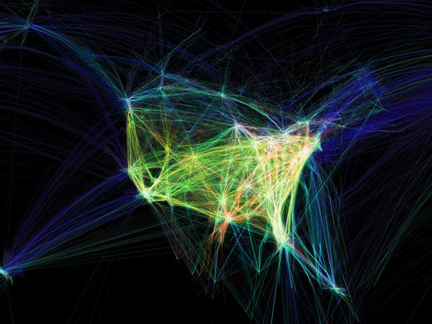
This course is about
How to generate visual representations of information (data) to communicate a message to a viewer
Focus is on:
Tools for visualization generation
Underlying principles that make for a good visualization
Hands-on practice with visualization generation
What is this?
Aaron Koblin: Flight Patterns
Notes:
Computer generated environment
Accurate position tracking and stereo rendering → perceive a 3D environment
Is interactive
Feels real

Slide 5
This course is NOT about
Data science/mining
High-level seminar/overview (you will need to program)
Web development
Data processing/statistics (R, excel, etc.)
Notes:
Computer generated environment
Accurate position tracking and stereo rendering → perceive a 3D environment
Is interactive
Feels real

Slide 6
You can/should
Interrupt me anytime with questions
Ask technical/engineering questions to me/TA
Discuss lecture content with peers
Version control your code
Request extension/absence with a reason
Notes:
Computer generated environment
Accurate position tracking and stereo rendering → perceive a 3D environment
Is interactive
Feels real

Slide 7
You CANNOT
Collaborate with peers on assignments
Work that you submit must be your own
Copy code/text from online/others/any resource – we will perform plagiarism check:
Acknowledge if you got help from somewhere/someone
Code and text you write must be your own
F if you do any of these
Notes:
Computer generated environment
Accurate position tracking and stereo rendering → perceive a 3D environment
Is interactive
Feels real

Slide 8
Syllabus

Slide 9
Course Objectives
How and why visualizations work
Visual perception system
Effective encoding channels for types of data
What kind of problems visualizations can solve
How to create effective visualizations
Tools and programming fundamentals
Identify which aspects of a data set can/should be visualized
Research skills
Reading and comprehending state-of-the-art research literature
Presenting your work in a clear, effective manner
Hands-on experience
Assignments and final project
Notes:
Computer generated environment
Accurate position tracking and stereo rendering → perceive a 3D environment
Is interactive
Feels real

Slide 10
Prerequisites
Programming
Python (matplotlib and Bokeh)
Javascript (use at your own risk!)
Data structures and algorithms
Academic writing
LaTeX
Notes:
Computer generated environment
Accurate position tracking and stereo rendering → perceive a 3D environment
Is interactive
Feels real

Slide 11

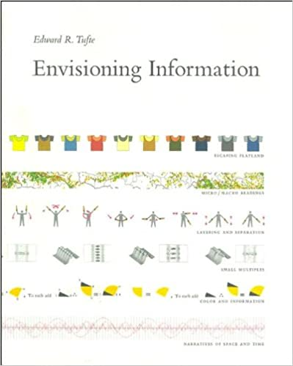

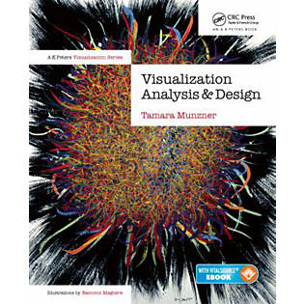
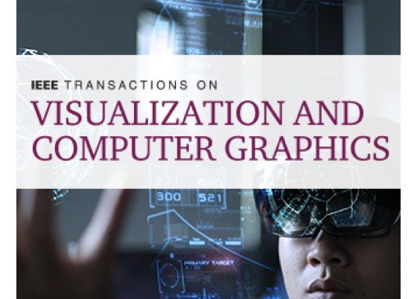


Materials
Notes:
Computer generated environment
Accurate position tracking and stereo rendering → perceive a 3D environment
Is interactive
Feels real

Slide 12
Assignments and grading
15% x 4 assignments (mini projects)
Work alone
Create visualization(s) and short written report
Someone presents their work at the start of a lecture (<5 mins)
Late policy:
3 late credits that allow you to extend an assignment deadline by 24 hours per credit
A linear late penalty will be applied to assignments, up to 3 days
For example, if your assignment is 12 hours late, you will receive a 16.66% penalty (12/72 = 16.66)
Late assignments due to illness or unexpected events can be excused with doctor’s notes or other forms of written indication
Cannot be applied to the final project!
10% Survey article + project proposal
Project topic of your choice
Work in groups of up to 3 people
30% Final project
Visualization(s), written report, and final presentation
Notes:
Computer generated environment
Accurate position tracking and stereo rendering → perceive a 3D environment
Is interactive
Feels real

Slide 13
Course Content

Slide 14
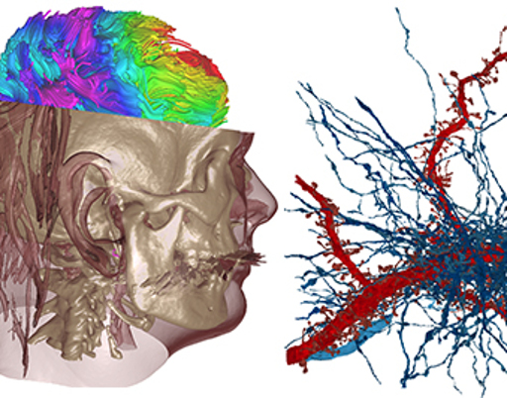
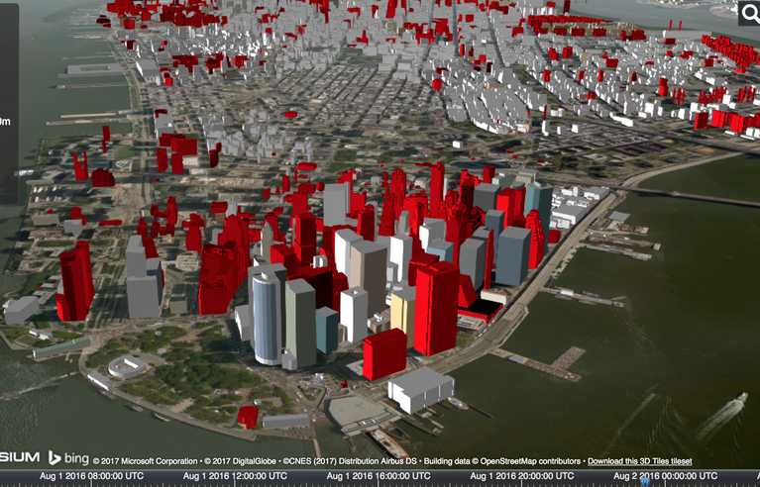
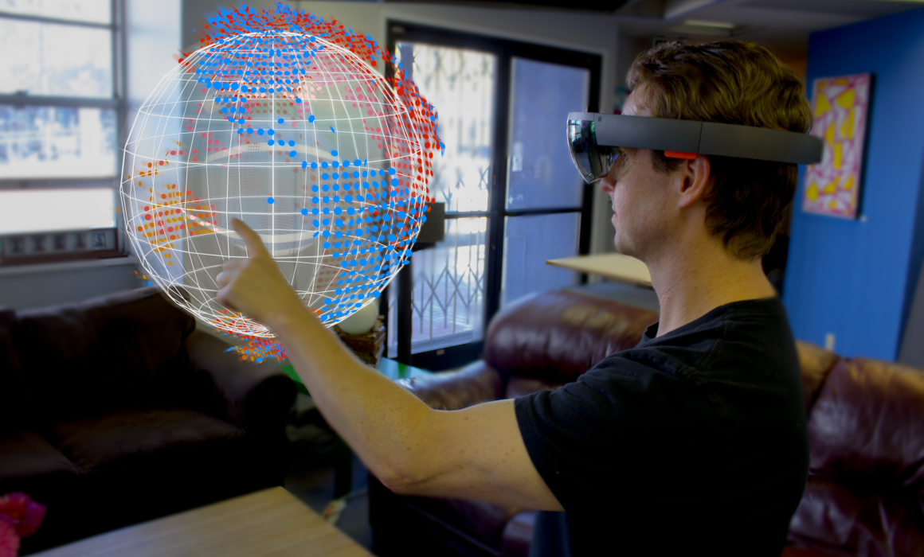
What is data visualization?
Graphical representation of data or concepts
The point is to communicate a message
Notes:
Computer generated environment
Accurate position tracking and stereo rendering → perceive a 3D environment
Is interactive
Feels real

Slide 15
Visualization components
Perceptually-grounded theories of color and graphics
Scientific visualization
Information visualization
Interfaces
Notes:
Computer generated environment
Accurate position tracking and stereo rendering → perceive a 3D environment
Is interactive
Feels real

Slide 16
Scientific vs Information Visualization
Scientific Visualization
Information Visualization
Notes:
Computer generated environment
Accurate position tracking and stereo rendering → perceive a 3D environment
Is interactive
Feels real

Slide 17
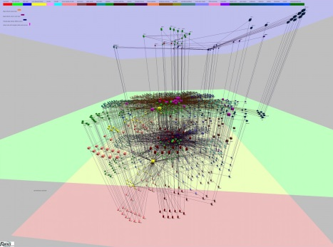
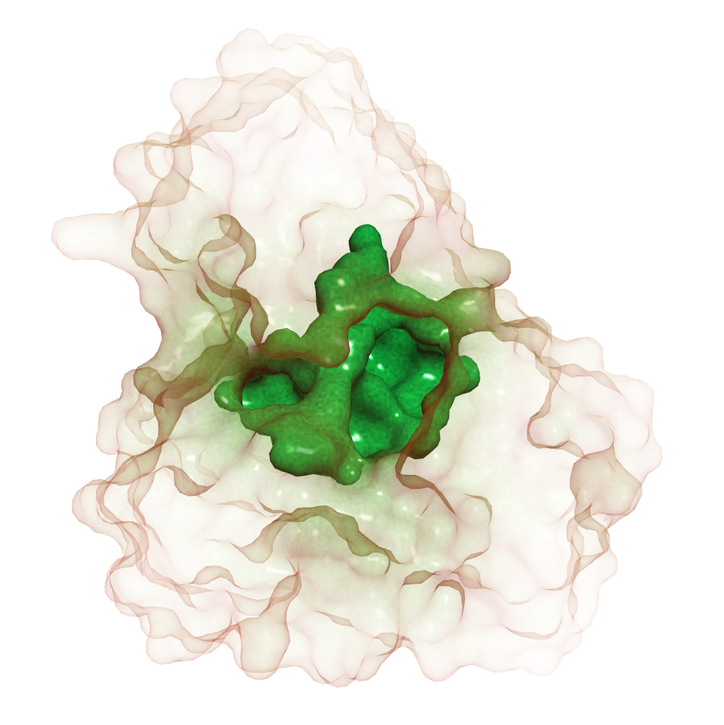
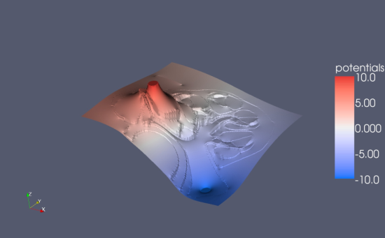
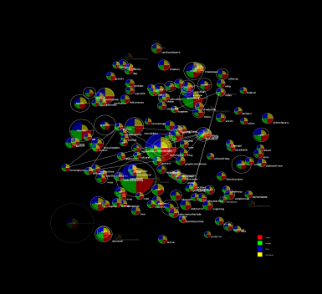
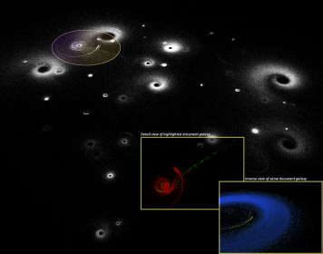
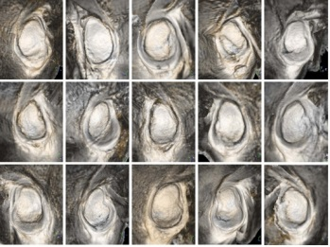
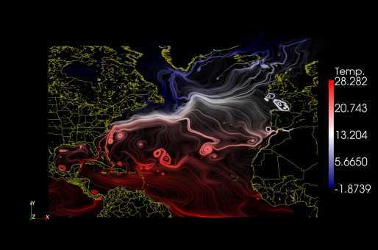
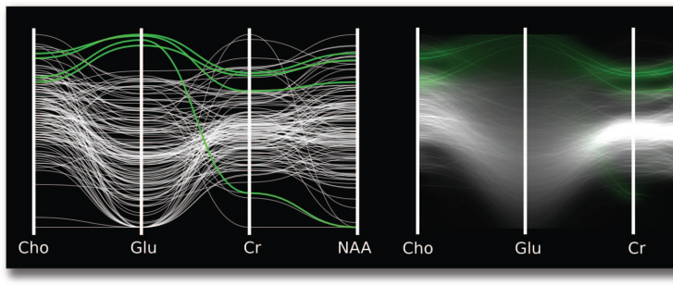

Scientific vs Information Visualization
Scientific Visualization
Information Visualization
Hong Yi, RENCI
Jeff Heard, RENCI
David Feng, UNC
Jeff Heard, RENCI
Notes:
Computer generated environment
Accurate position tracking and stereo rendering → perceive a 3D environment
Is interactive
Feels real

Slide 18
Scientific vs Information Visualization
Scientific Visualization
Spatially-embedded data
Information Visualization
Abstract data
Hong Yi, RENCI
Jeff Heard, RENCI
David Feng, UNC
Jeff Heard, RENCI
Notes:
Computer generated environment
Accurate position tracking and stereo rendering → perceive a 3D environment
Is interactive
Feels real

Slide 19

Live “demo”
tinyurl.com/bdecrt33
Notes:
Computer generated environment
Accurate position tracking and stereo rendering → perceive a 3D environment
Is interactive
Feels real

Slide 20
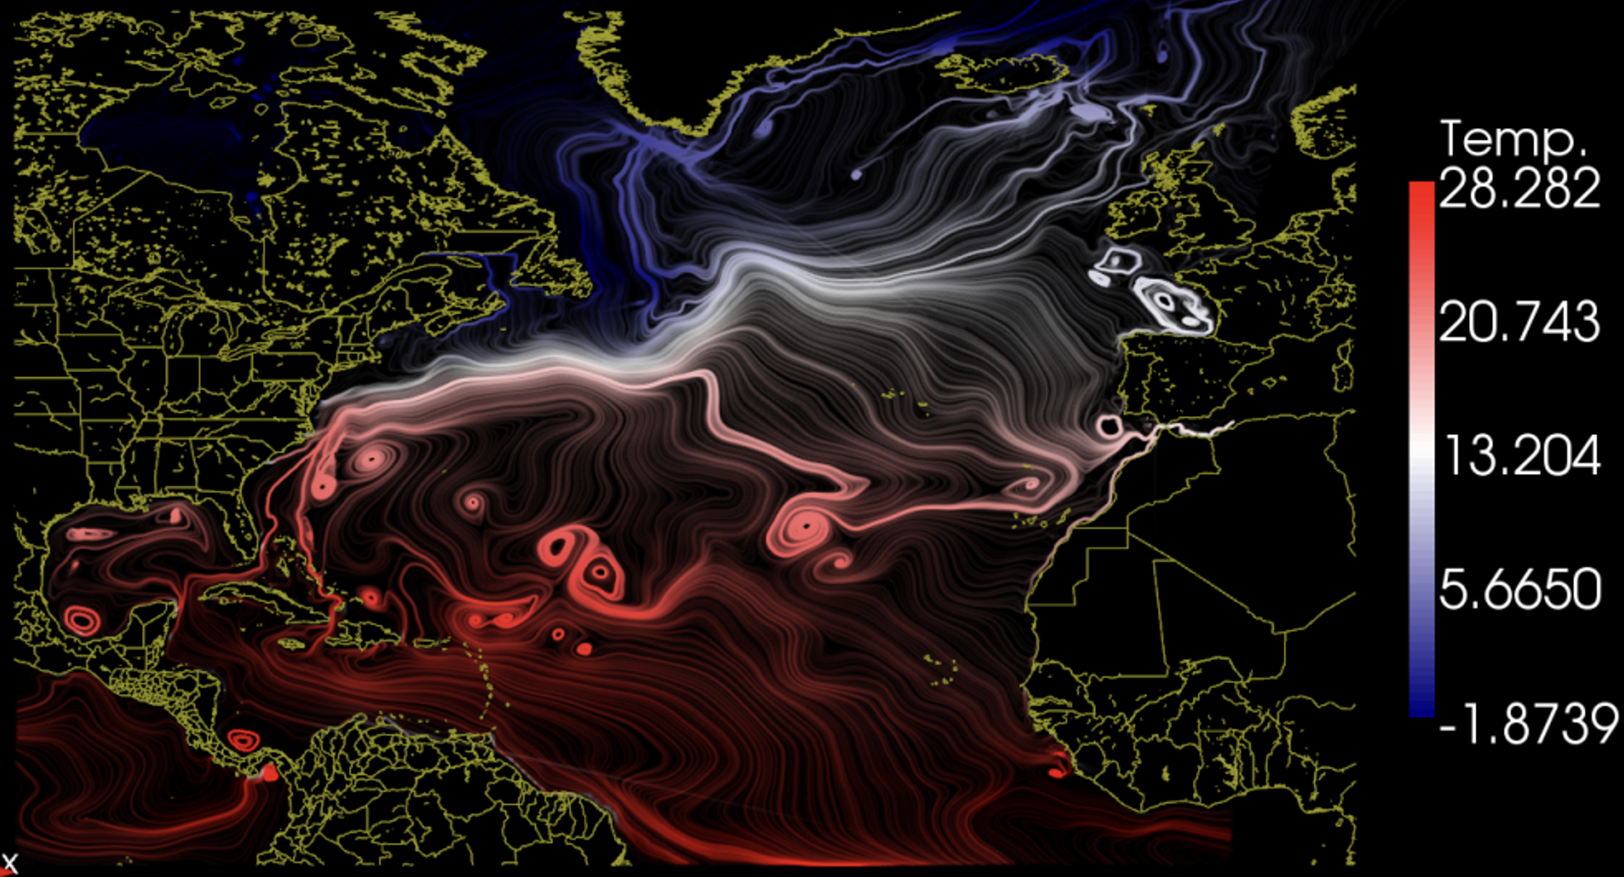
Advantages of data viz
Comprehend huge amounts of data
Notes:
Computer generated environment
Accurate position tracking and stereo rendering → perceive a 3D environment
Is interactive
Feels real

Slide 21
Advantages of data viz
Facilitates simultaneous understanding of both large-scale and small-scale features
Notes:
Computer generated environment
Accurate position tracking and stereo rendering → perceive a 3D environment
Is interactive
Feels real

Slide 22
Advantages of data viz
Enables the perception of emergent properties that were not anticipated and makes problems with the data collection/simulation apparent
Notes:
Computer generated environment
Accurate position tracking and stereo rendering → perceive a 3D environment
Is interactive
Feels real

Slide 23
Advantages of data viz
Enables the perception of emergent properties that were not anticipated and makes problems with the data collection/simulation apparent
Notes:
Computer generated environment
Accurate position tracking and stereo rendering → perceive a 3D environment
Is interactive
Feels real

Slide 24
Advantages of data viz
Facilitates hypothesis formation
Notes:
Vortices only in the medium-warmth region!

Slide 25
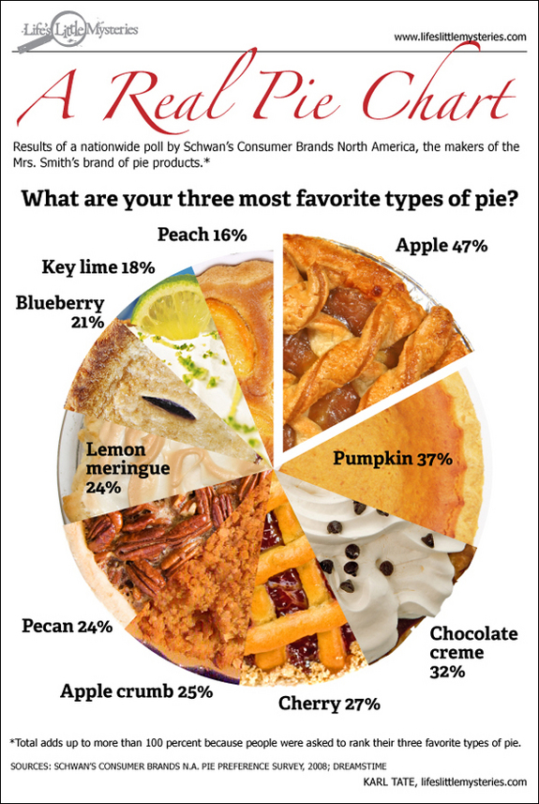
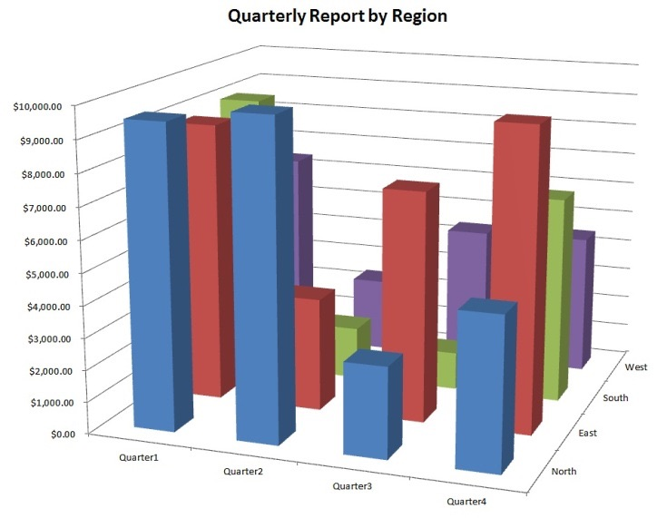
Very easy to do it poorly
viz.wtf for more

Slide 26
Considerations when creating visualizations
Notes:
Computer generated environment
Accurate position tracking and stereo rendering → perceive a 3D environment
Is interactive
Feels real

Slide 27
Considerations when creating visualizations
Main question: How to transform data into something that people can understand for optimal decision making?
Notes:
Computer generated environment
Accurate position tracking and stereo rendering → perceive a 3D environment
Is interactive
Feels real

Slide 28
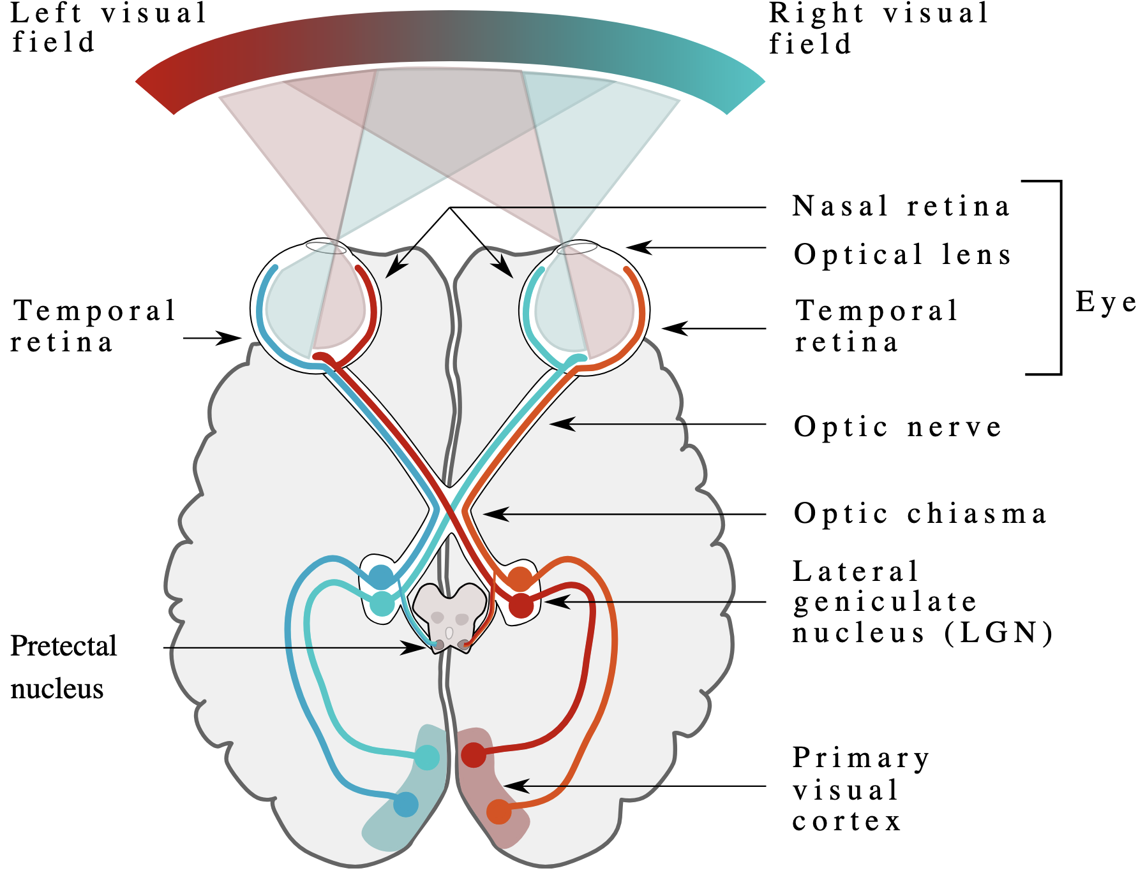
Considerations when creating visualizations
Main question: How to transform data into something that people can understand for optimal decision making?
Human visual system: How people see
Notes:
Computer generated environment
Accurate position tracking and stereo rendering → perceive a 3D environment
Is interactive
Feels real

Slide 29
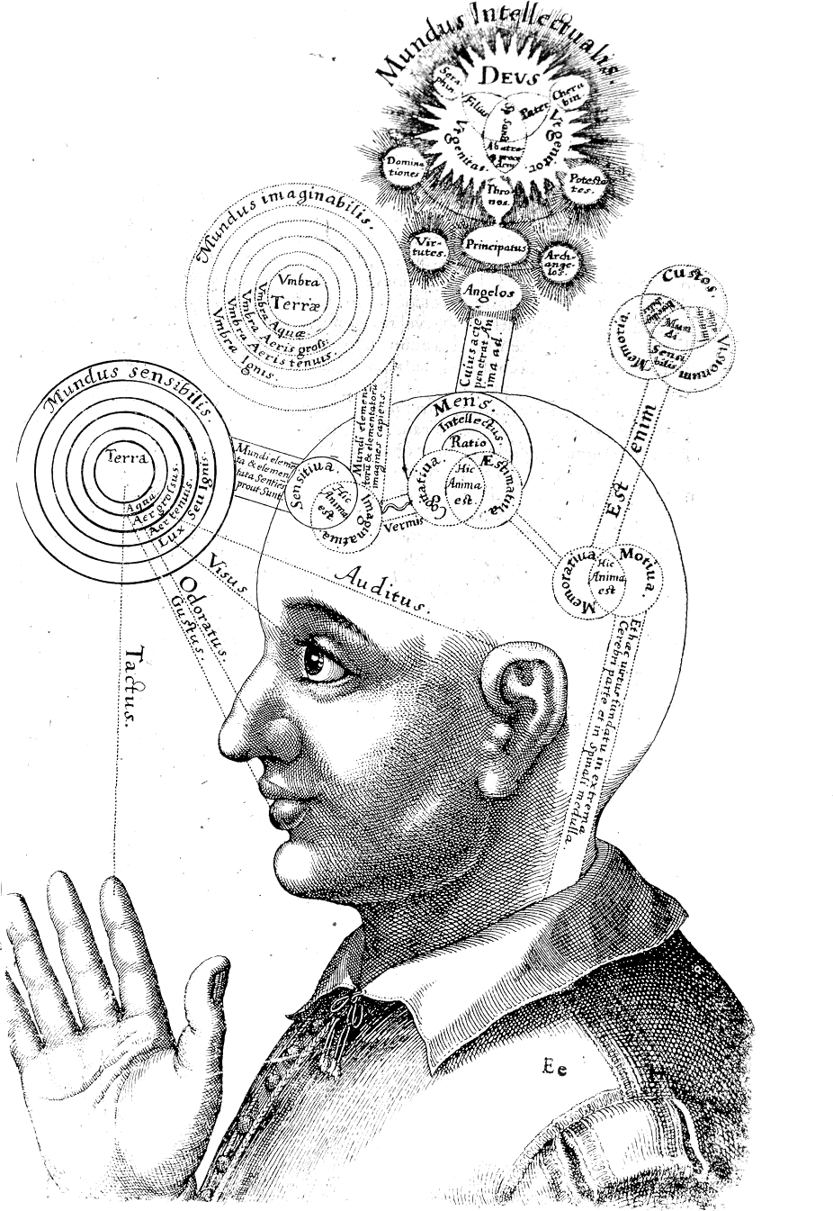
Considerations when creating visualizations
Main question: How to transform data into something that people can understand for optimal decision making?
Human visual system: How people see
Cognitive system: How people think
Notes:
Computer generated environment
Accurate position tracking and stereo rendering → perceive a 3D environment
Is interactive
Feels real

Slide 30

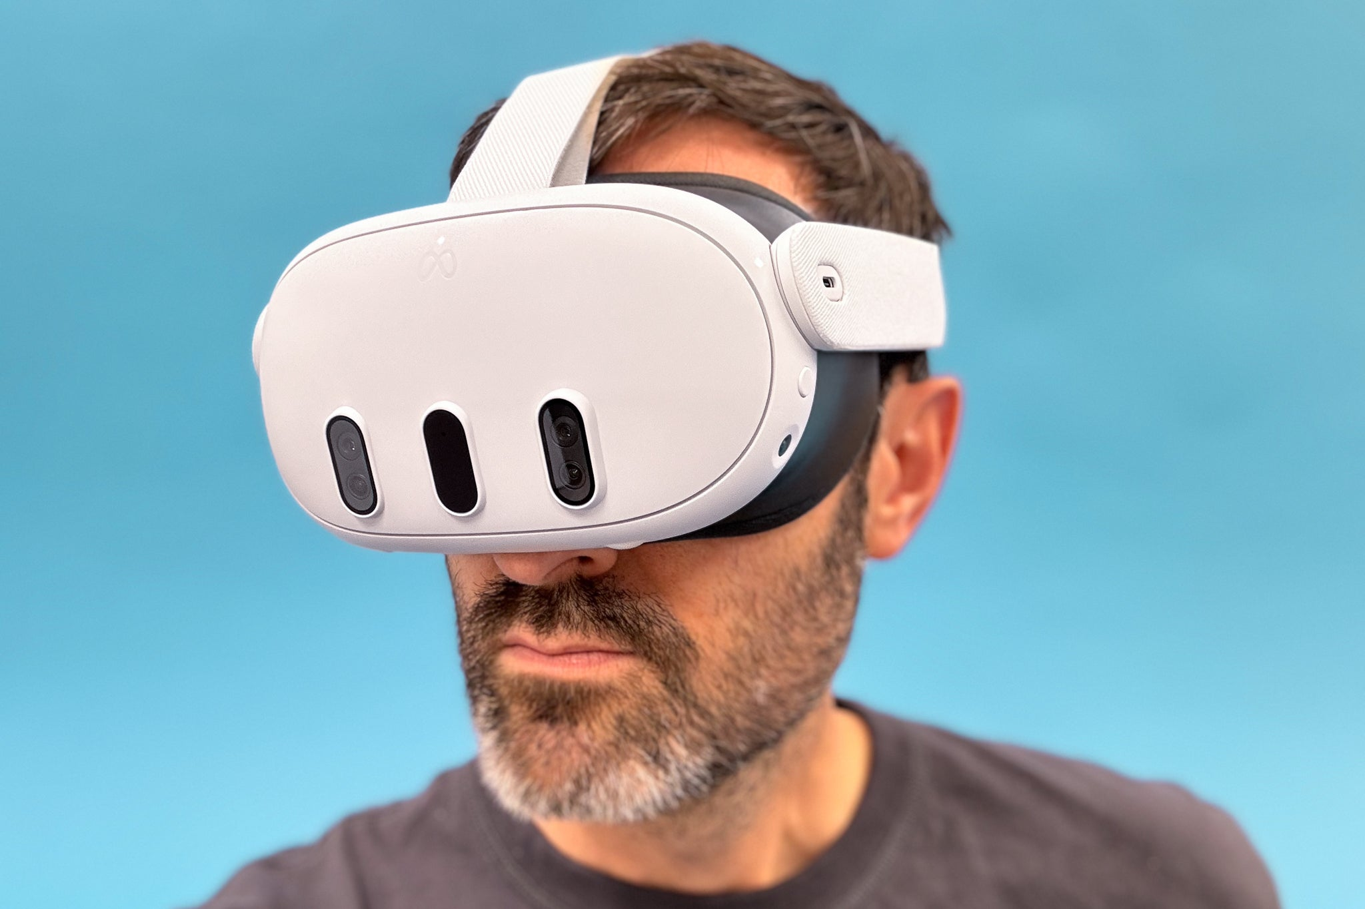
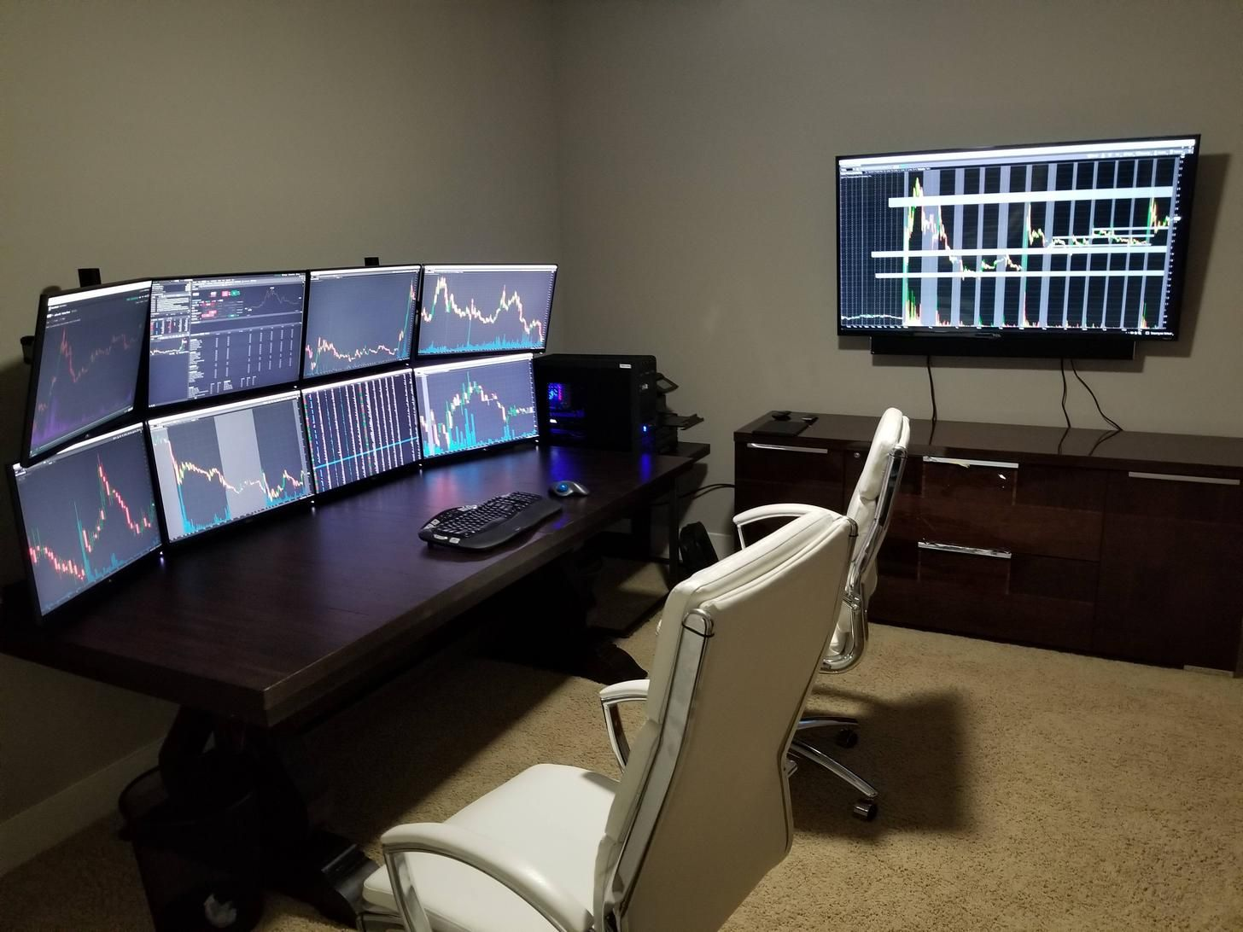
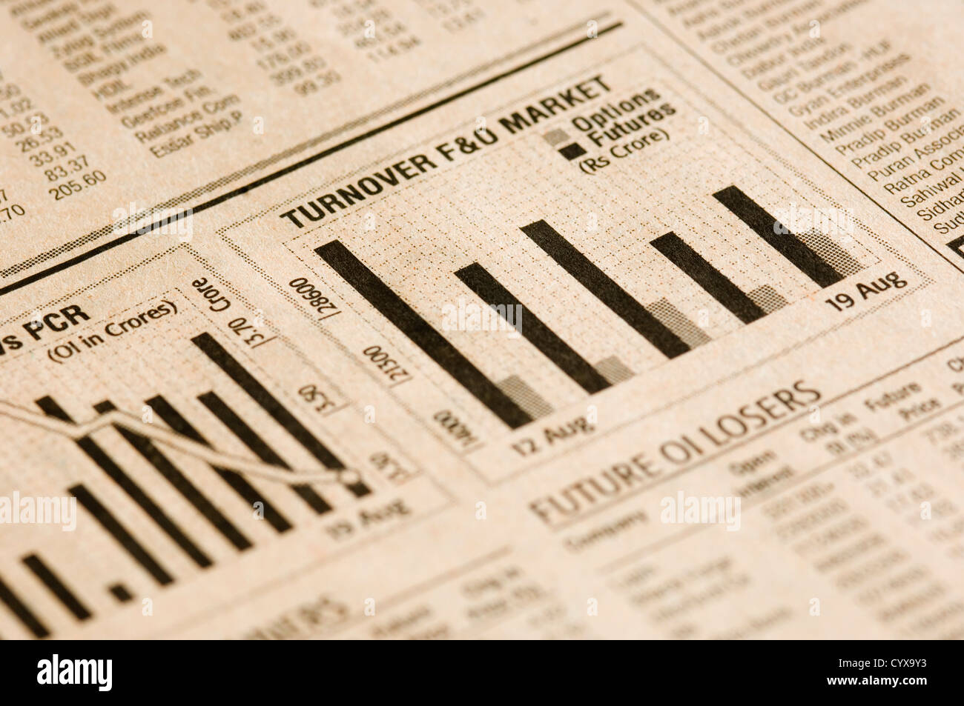
Considerations when creating visualizations
Main question: How to transform data into something that people can understand for optimal decision making?
Human visual system: How people see
Cognitive system: How people think
Display modality: How the viz will be displayed

Slide 31
Topics we will cover (approximately)
Week 1: Introduction, syllabus

Slide 32
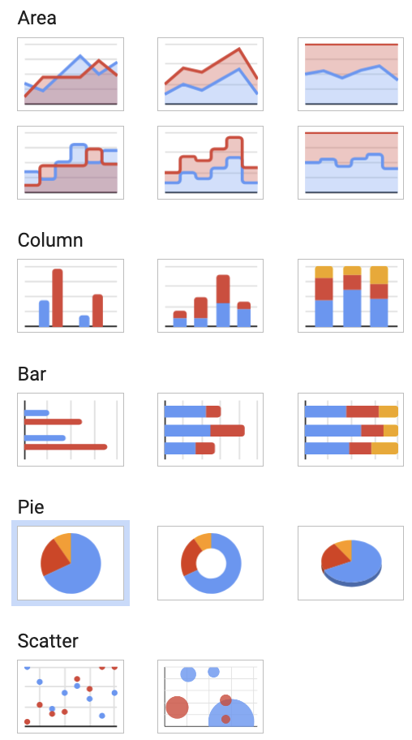

Topics we will cover (approximately)
Week 1: Introduction, syllabus
Week 2: Data types, viz techniques & tools
Python
Javascript (use at your own risk)

Slide 33
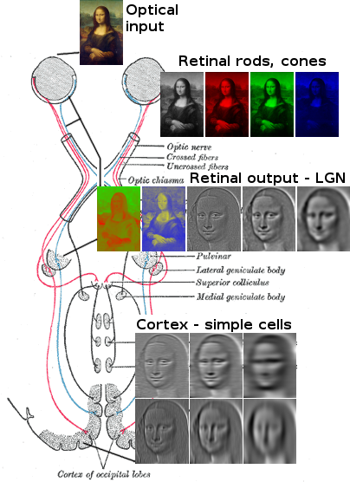
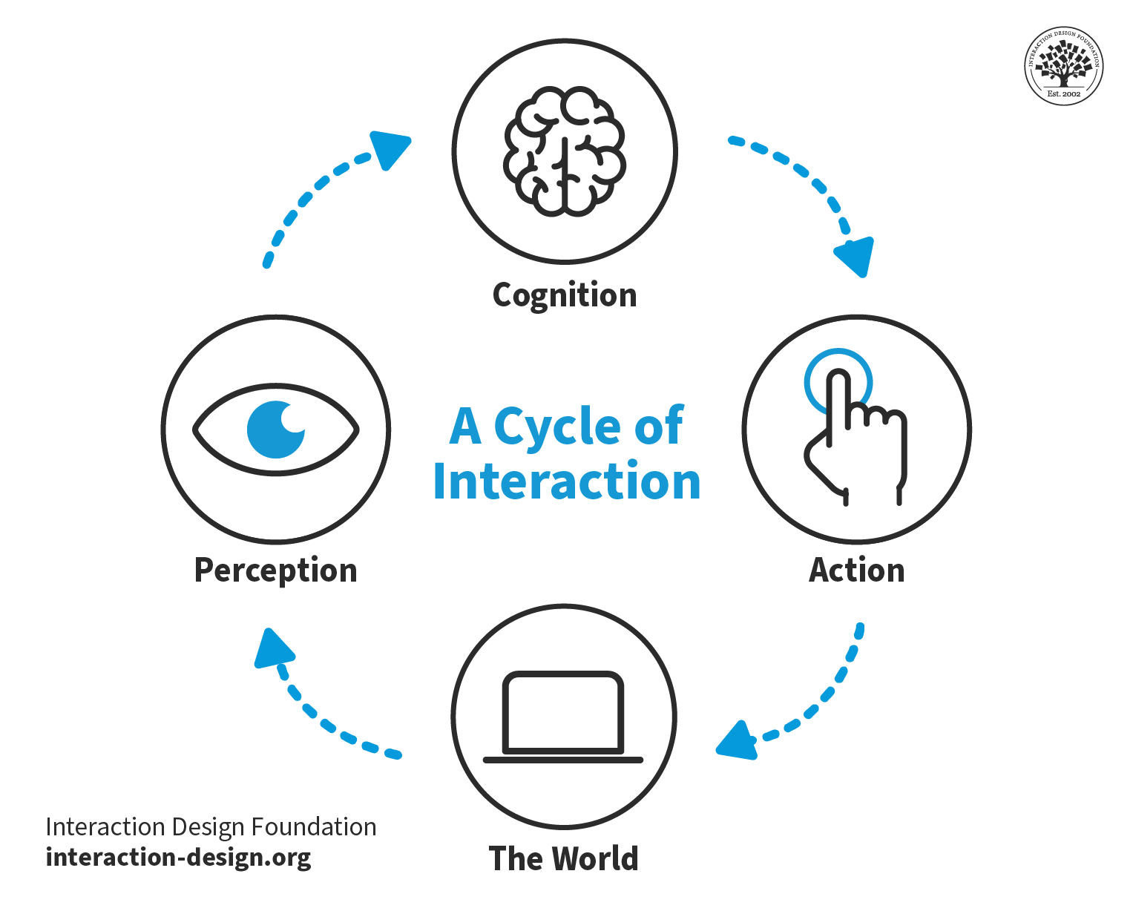
Topics we will cover (approximately)
Week 1: Introduction, syllabus
Week 2: Data types, viz techniques & tools
Week 3: The human visual system

Slide 34
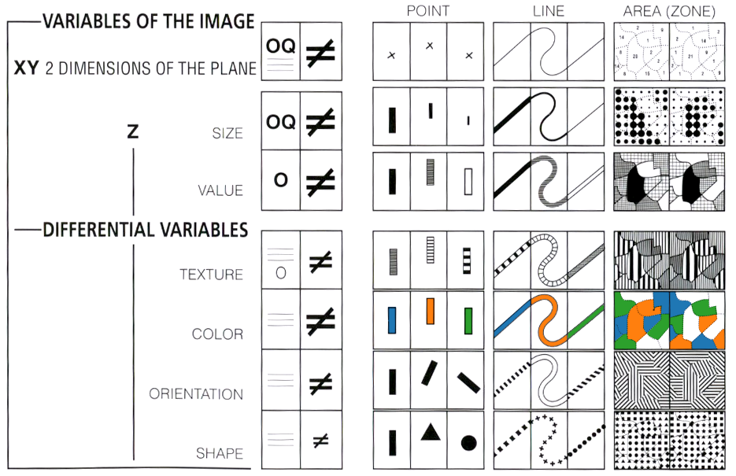
Topics we will cover (approximately)
Week 1: Introduction, syllabus
Week 2: Data types, viz techniques & tools
Week 3: The human visual system
Week 4: Visual encoding + perception
https://idl.uw.edu/visualization-curriculum/intro.html

Slide 35
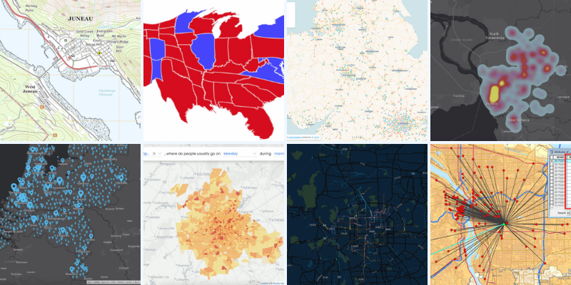
Topics we will cover (approximately)
Week 1: Introduction, syllabus
Week 2: Data types, viz techniques & tools
Week 3: The human visual system
Week 4: Visual encoding + perception
Week 5: 2D viz - spatial data
https://www.safegraph.com/guides/visualizing-geospatial-data

Slide 36
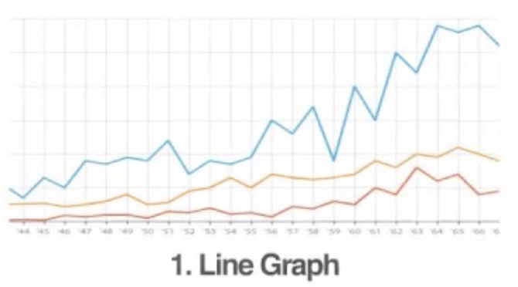
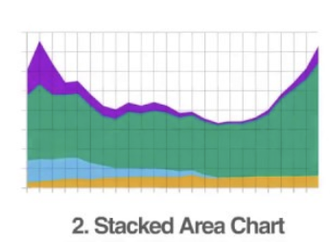
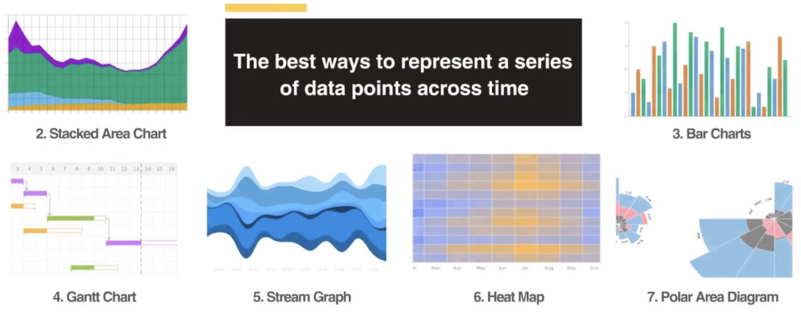
Topics we will cover (approximately)
Week 1: Introduction, syllabus
Week 2: Data types, viz techniques & tools
Week 3: The human visual system
Week 4: Visual encoding + perception
Week 5: 2D viz - spatial data
Week 6: 2D viz - temporal data
https://humansofdata.atlan.com/2016/11/visualizing-time-series-data/

Slide 37
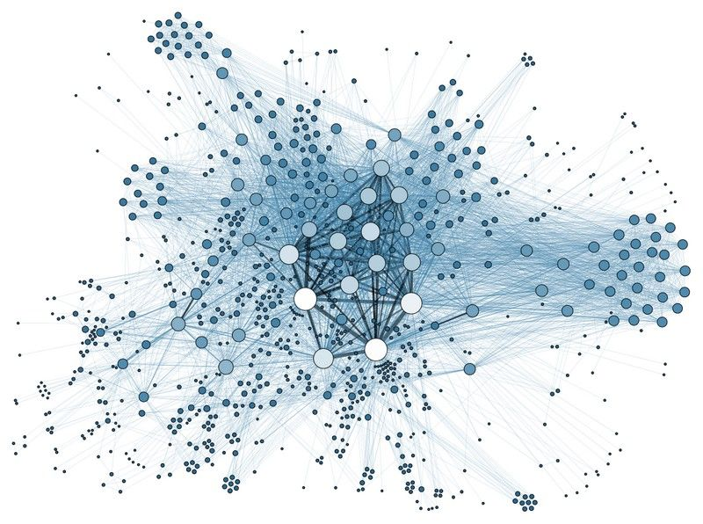
Topics we will cover (approximately)
Week 1: Introduction, syllabus
Week 2: Data types, viz techniques & tools
Week 3: The human visual system
Week 4: Visual encoding + perception
Week 5: 2D viz - spatial data
Week 6: 2D viz - temporal data
Week 7: 2D viz - network data
https://www.interaction-design.org/literature/article/how-to-display-complex-network-data-with-information-visualization

Slide 38
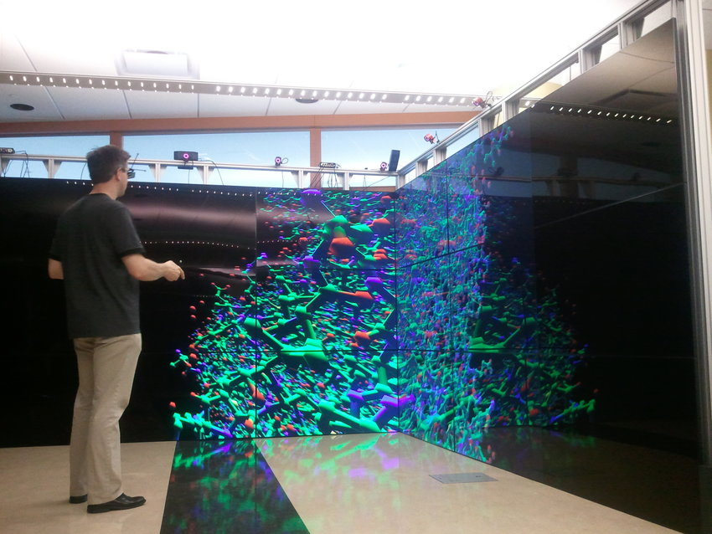
Topics we will cover (approximately)
Week 1: Introduction, syllabus
Week 2: Data types, viz techniques & tools
Week 3: The human visual system
Week 4: Visual encoding + perception
Week 5: 2D viz - spatial data
Week 6: 2D viz - temporal data
Week 7: 2D viz - network data
Week 8: 3D viz - projection & graphics
Wischgoll, Thomas, et al. "Display infrastructure for virtual environments." Electronic Imaging 30 (2017): 1-11.

Slide 39
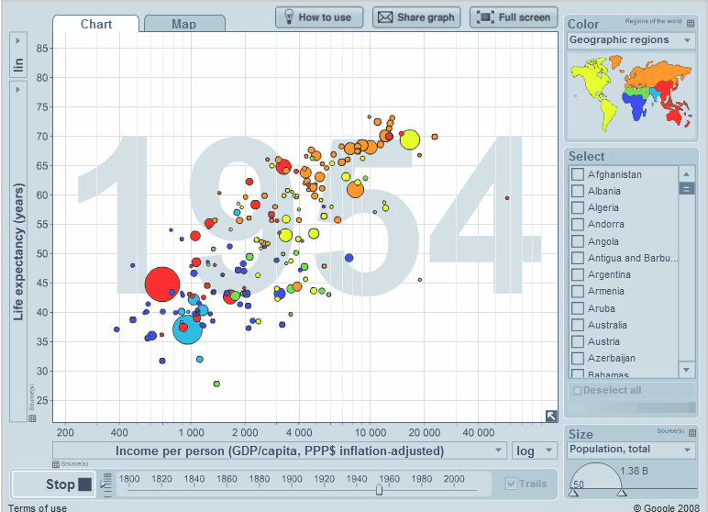
Topics we will cover (approximately)
Week 1: Introduction, syllabus
Week 2: Data types, viz techniques & tools
Week 3: The human visual system
Week 4: Visual encoding + perception
Week 5: 2D viz - spatial data
Week 6: 2D viz - temporal data
Week 7: 2D viz - network data
Week 8: 3D viz - projection & graphics
Week 9: Animation
https://www.gapminder.org/videos/200-years-that-changed-the-world/

Slide 40
Topics we will cover (approximately)
Week 1: Introduction, syllabus
Week 2: Data types, viz techniques & tools
Week 3: The human visual system
Week 4: Visual encoding + perception
Week 5: 2D viz - spatial data
Week 6: 2D viz - temporal data
Week 7: 2D viz - network data
Week 8: 3D viz - projection & graphics
Week 9: Animation
Week 10: Final project proposals

Slide 41
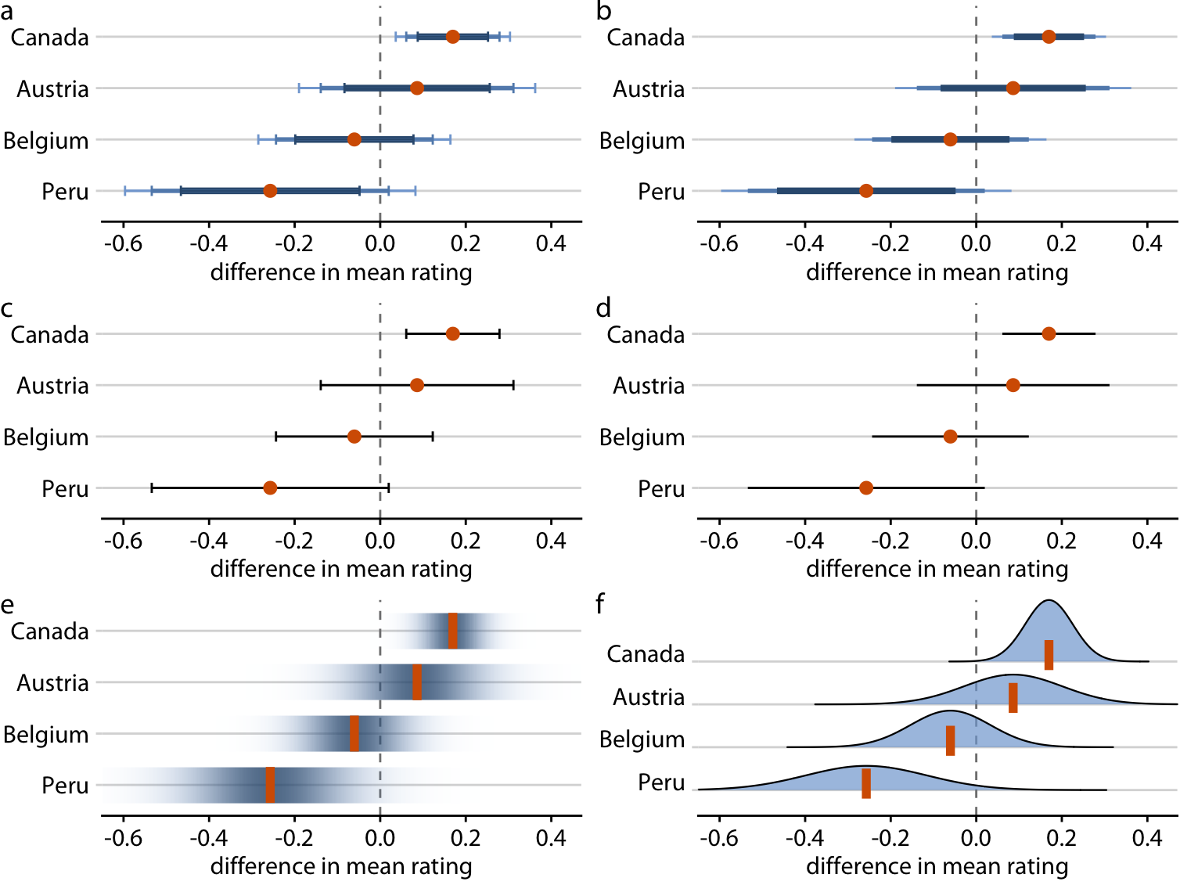
Topics we will cover (approximately)
Week 1: Introduction, syllabus
Week 2: Data types, viz techniques & tools
Week 3: The human visual system
Week 4: Visual encoding + perception
Week 5: 2D viz - spatial data
Week 6: 2D viz - temporal data
Week 7: 2D viz - network data
Week 8: 3D viz - projection & graphics
Week 9: Animation
Week 10: Final project proposals
Week 11: Uncertainty viz
https://clauswilke.com/dataviz/visualizing-uncertainty.html

Slide 42
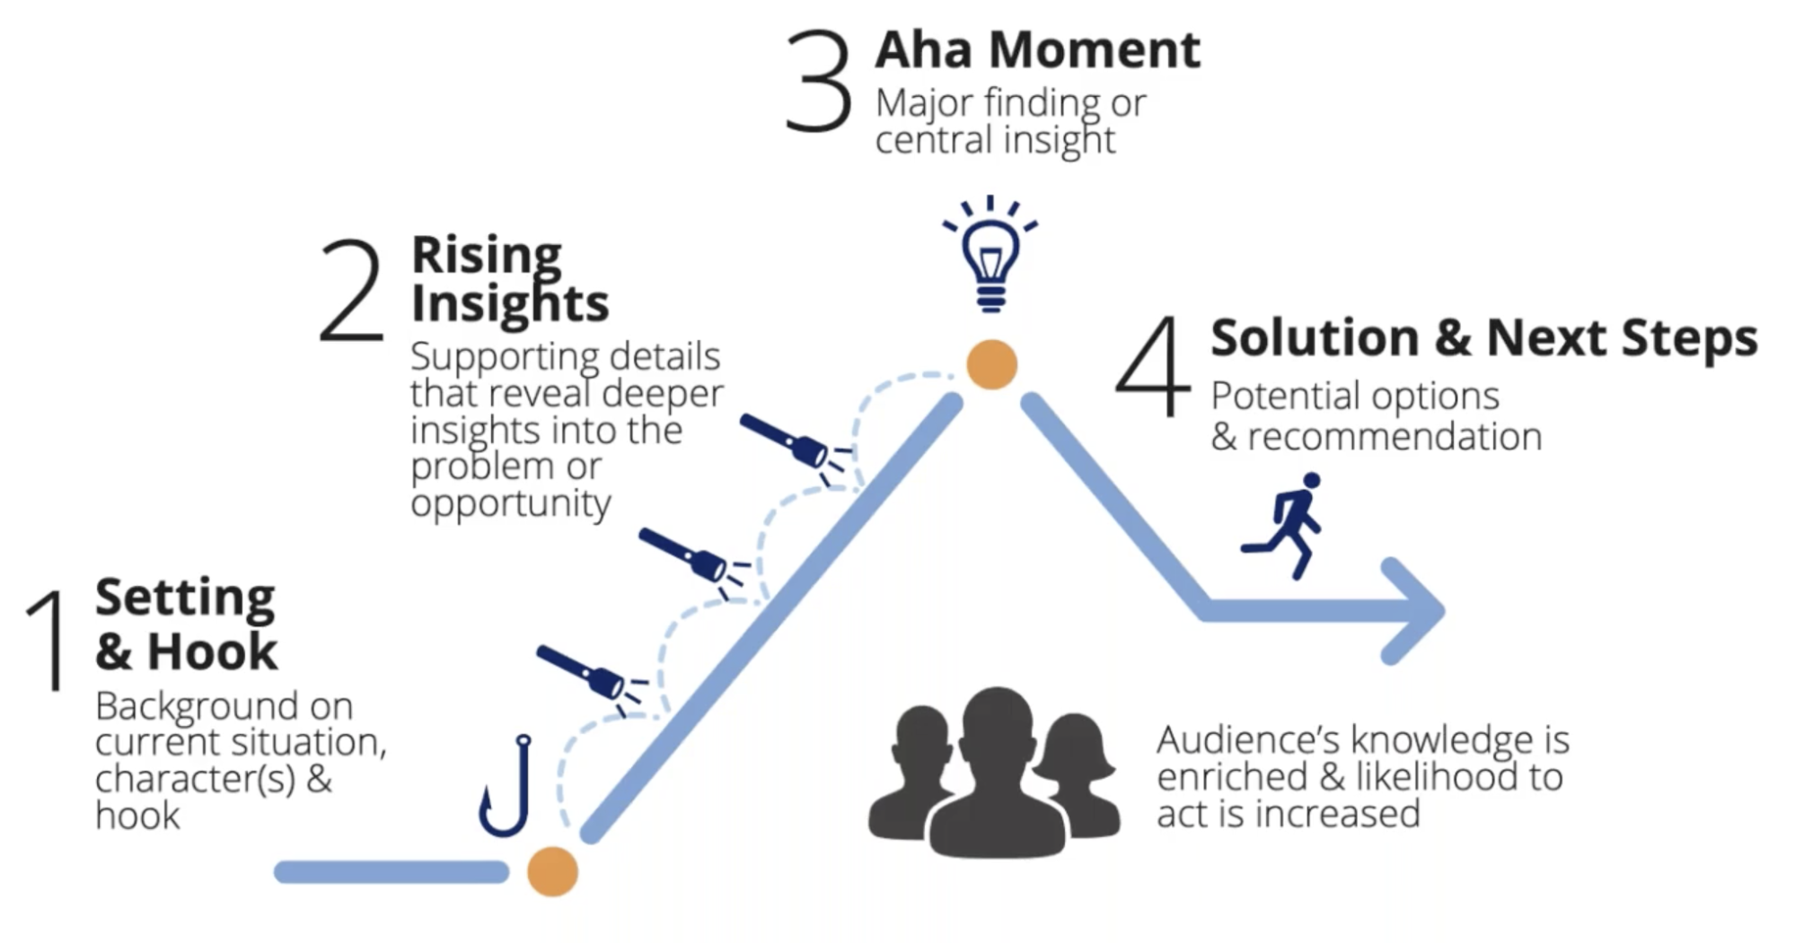
Topics we will cover (approximately)
Week 1: Introduction, syllabus
Week 2: Data types, viz techniques & tools
Week 3: The human visual system
Week 4: Visual encoding + perception
Week 5: 2D viz - spatial data
Week 6: 2D viz - temporal data
Week 7: 2D viz - network data
Week 8: 3D viz - projection & graphics
Week 9: Animation
Week 10: Final project proposals
Week 11: Uncertainty viz
Week 12: Storytelling, ethics, and misinformation
https://www.datacamp.com/blog/telling-effective-data-stories-with-data-narrative-and-visuals

Slide 43
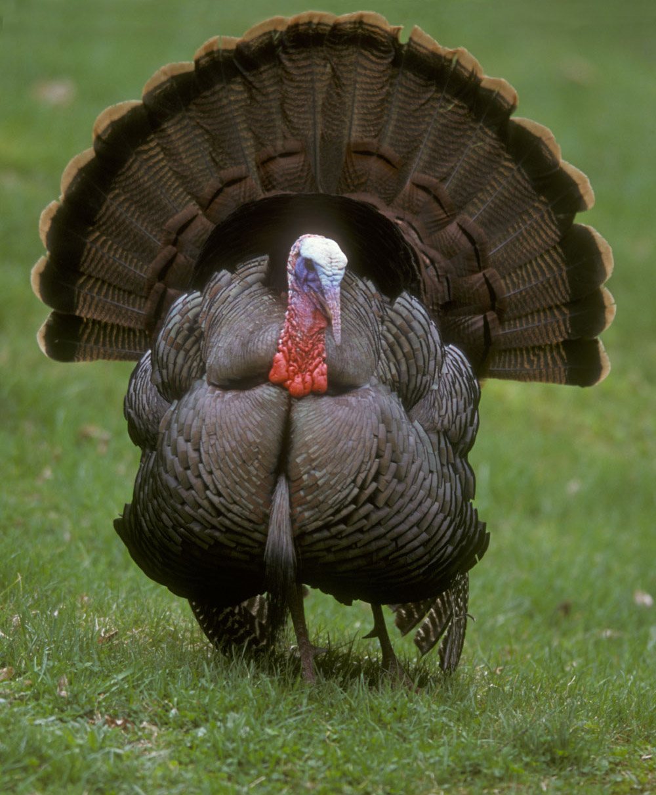

Topics we will cover (approximately)
Week 1: Introduction, syllabus
Week 2: Data types, viz techniques & tools
Week 3: The human visual system
Week 4: Visual encoding + perception
Week 5: 2D viz - spatial data
Week 6: 2D viz - temporal data
Week 7: 2D viz - network data
Week 8: 3D viz - projection & graphics
Week 9: Animation
Week 10: Final project proposals
Week 11: Uncertainty viz
Week 12: Storytelling, ethics, and misinformation
Week 13: 🦃 Thanksgiving Break 🦃

Slide 44
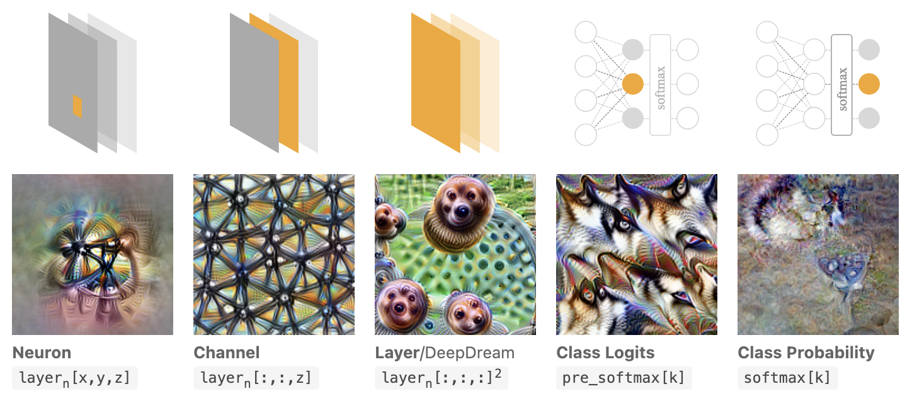
Topics we will cover (approximately)
Week 1: Introduction, syllabus
Week 2: Data types, viz techniques & tools
Week 3: The human visual system
Week 4: Visual encoding + perception
Week 5: 2D viz - spatial data
Week 6: 2D viz - temporal data
Week 7: 2D viz - network data
Week 8: 3D viz - projection & graphics
Week 9: Animation
Week 10: Final project proposals
Week 11: Uncertainty viz
Week 12: Storytelling, ethics, and misinformation
Week 13: 🦃 Thanksgiving Break 🦃
Week 14: Modern topics: deep learning/XR/interaction
https://distill.pub/2017/feature-visualization/

Slide 45
Topics we will cover (approximately)
Week 1: Introduction, syllabus
Week 2: Data types, viz techniques & tools
Week 3: The human visual system
Week 4: Visual encoding + perception
TODO: bump up uncertainty before the election/voting
Week 5: 2D viz - spatial data
Week 6: 2D viz - temporal data
Week 7: 2D viz - network data
Week 8: 3D viz - projection & graphics
Week 9: Animation
Week 10: Final project proposals
Week 11: Uncertainty viz
Week 12: Storytelling, ethics, and misinformation
Week 13: 🦃 Thanksgiving Break 🦃
Week 14: Modern topics: deep, learning/XR/interaction
Week 15: Final project presentations
Your work here!

Slide 46
Why?

Slide 47
Why have a user in the loop?
We want to communicate a message
A message is useless without a recipient!
Data viz allows users to answer/formulate questions
Questions that machines can’t answer/formulate → Let the user explore with viz!
Use viz as a stepping-stone to developing a computer-based answer
Use viz as a “sanity check”
Data viz can be used as a presentation tool

Slide 48
Why have a computer in the loop?
Lots of data → need to process it all
Can’t draw all visualizations by hand
Different questions may require different processing
Data might change in real time

Slide 49
Why use an external representation?
Renderings on a screen are external representations
Allows you to:
Organize info by spatial organization
Offload internal cognition
Speed up recognition and search (leverage fast visual processing)

Slide 50
Why use human vision?
What about other perceptual channels like auditory, haptic, taste, etc.?
Visual perception is fast and high bandwidth
You can process more information visually than with other senses
We have appropriate devices for vision
Computer displays are very advanced
Non-visual displays are clunky and expensive and still work poorly

Slide 51
Why show the data in detail?
Why not just use summary statistics?

Slide 52
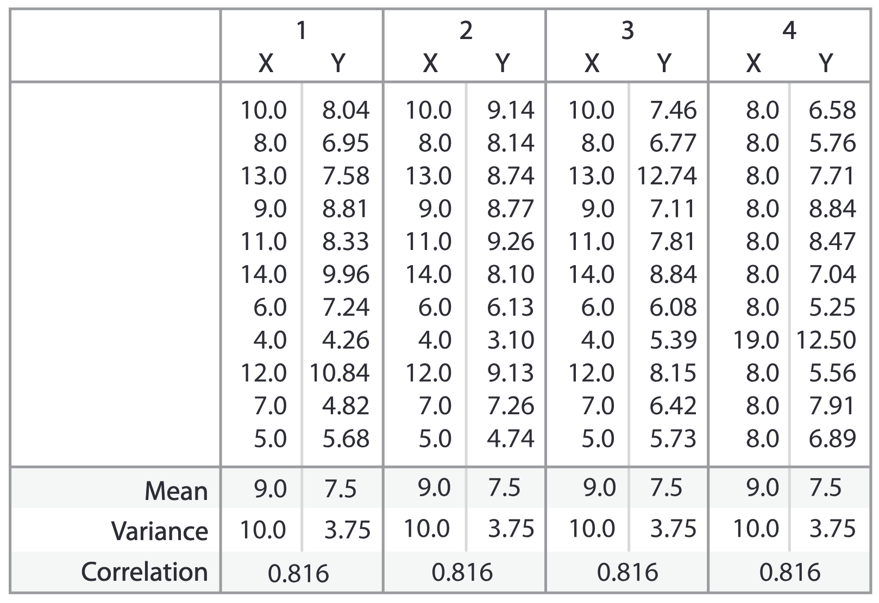
Why show the data in detail?
Why not just use summary statistics?
Anscombe’s Quartet

Slide 53
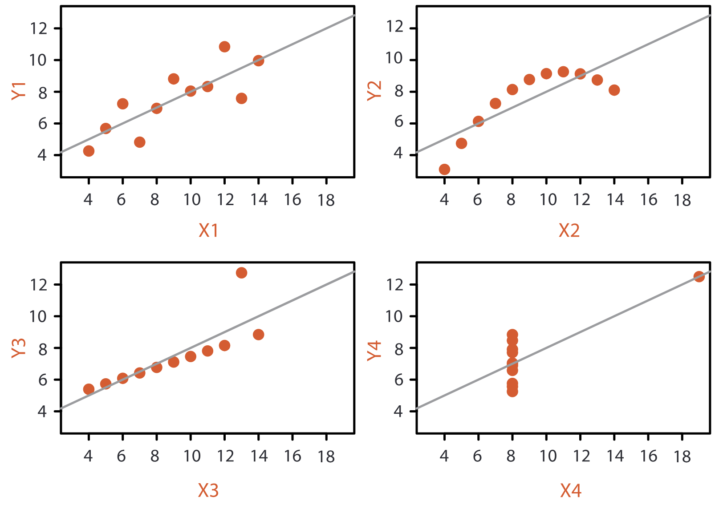
Why show the data in detail?
Why not just use summary statistics?
Anscombe’s Quartet

Slide 54
Why show the data in detail?
Why not just use summary statistics?
Specific questions likely require detailed insights into the data

Slide 55
Why is the viz design space so big?
In short: data is complex and there are many visual encodings
A single data type can be represented with many different visual representations
A single question can have many different data dimensions that answer it
Notes:
Continuous scalar value can be mapped to size, opacity, length, position, etc.
One question about, eg, fitness can be answered by data about sleep, exercise, diet, mental health, etc.

Slide 56
Why consider different tasks?
Remember: we want to communicate a message
Different messages are best communicated in different ways
Choose the technique that is best for your message

Slide 57
Why consider different tasks?
Remember: we want to communicate a message
Different messages are best communicated in different ways
Choose the technique that is best for your message
Nice to see you!
Nice to see you!
🙂
☹️

Slide 58
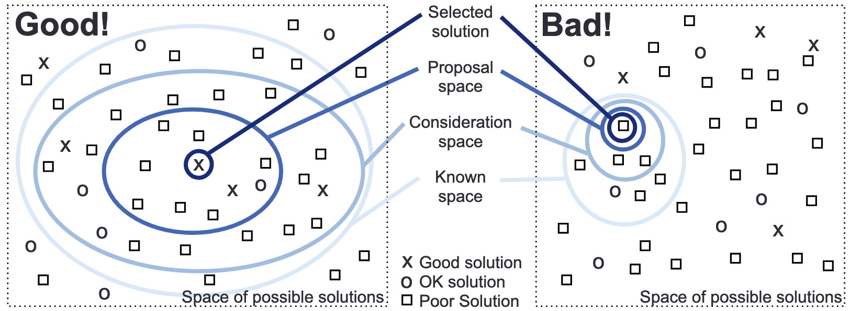
Why consider multiple techniques?
There are multiple possible visualizations
Some will be bad
Some will be okay
Some will be good
Consider many different options at once → more likely to consider a good design
Munzner, Tamara. Visualization analysis and design. CRC press, 2014.

Slide 59
Why is validation difficult?
Many reasonable ways to communicate one message
Different representations resonate differently for different people
Your audience’s understanding will be biased by their experiences
Hard to predict a person’s prior experiences
Users will do unexpected things
Hard to predict every possible thing a user will do/think
Many of our outcome measures are subjective
How do you measure “visually appealing”?

Slide 60
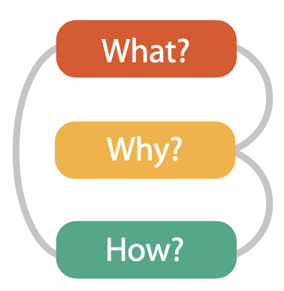
Why analyze existing visualizations?
Short answer: most data sets are not that unique → there probably exists a similar data set with an associated visualization
Learn from others’ mistakes and successes!
Why is the task being performed, what data is shown in the views, and how is the vis idiom constructed in terms of design choices.
Munzner, Tamara. Visualization analysis and design. CRC press, 2014.

Slide 61
10 Minute Break

Slide 62
Swearing map
https://word.tips/countries-swearing-map/

